Slide 1

How to be competitive when looking for Data Scientists
Auriana Anderson
Notes:
Hello my name is Auriana Anderson and this is my presentation on How to be competitive when looking for Data Scientist

Slide 2
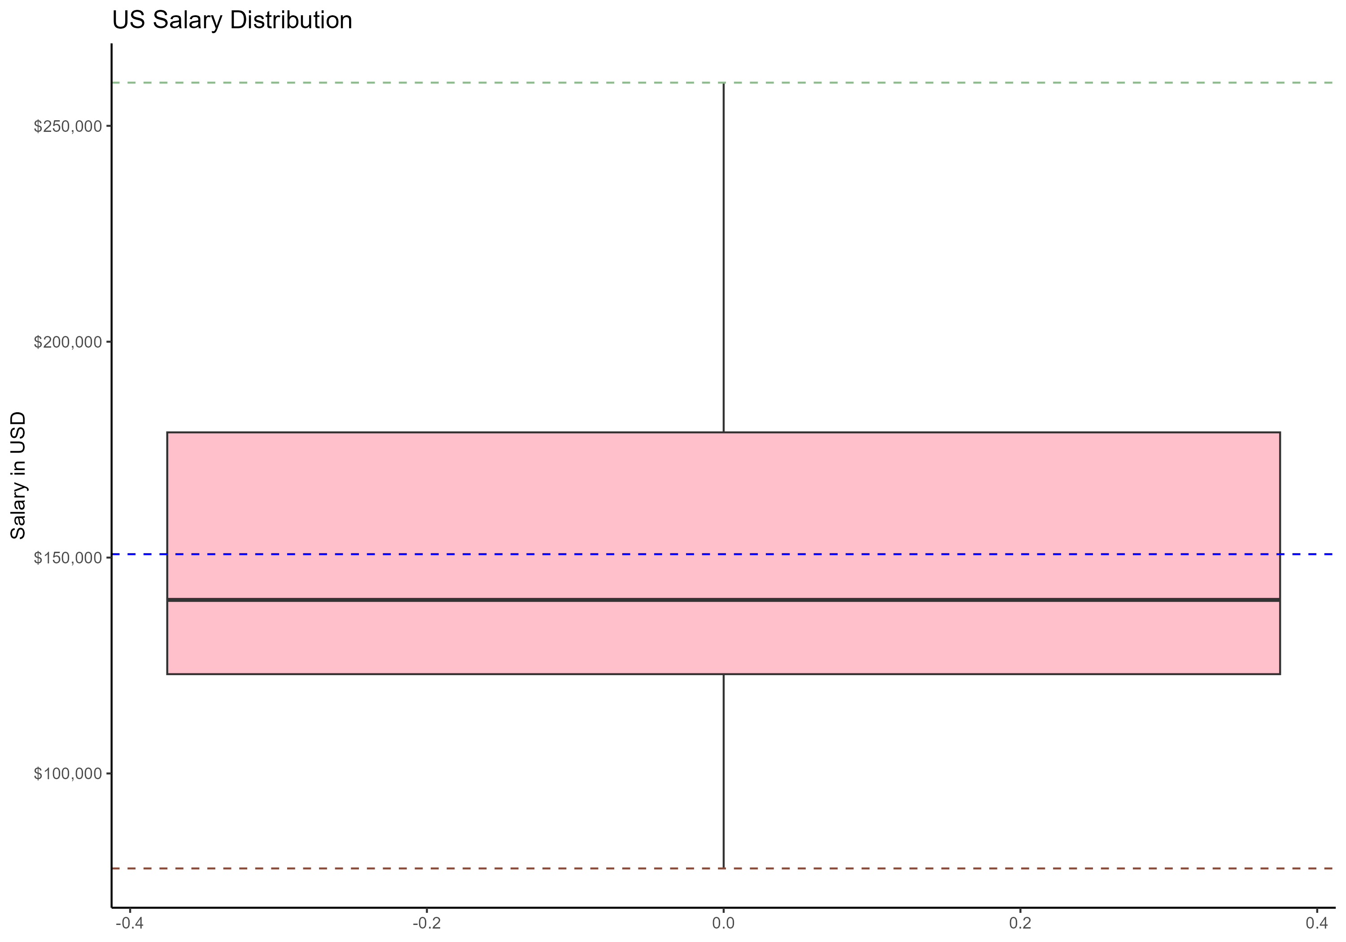
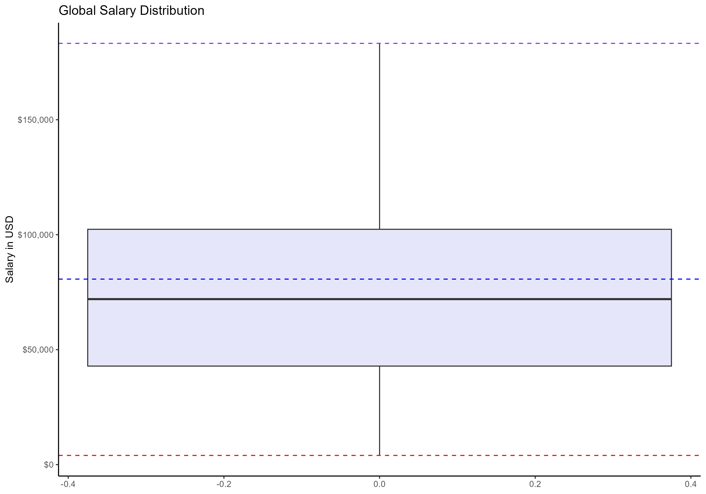
US Statistic | Value
Average US Salary | $150,786
Median US Salary | $140,200
Minimum US Salary | $78,000
Max US Salary | $260,000
IQR US Salary | $56,000
Global Statistic | Value
Global Average salary | $80,688
Global Minimum Salary | $4,000
Global Max Salary | $183,228
Global Median Salary | $71,982
Global IQR Salary | $59,490
Notes:
The first thing I did was filter the data so that the job titles only contained data scientist. From there I filtered it again to only contain data for medium sized businesses and these statistics were the resulting values. Data scientists were grouped as global vs US based off of their residence. Starting on the left, This is US data. The US has a salary range of $ 78,000 – $260,000. The median here which is the solid black horizontal line is $140,200. The reason the median is our focus here rather than the mean is because we have a mean of $150,786 which mean there are probably salaries in this data set skewing our average higher than our median. The median is more reliable because it tells us where our central salaries are. For the US we have an IQR salary of $56,000. Which helps us calculate our 25th percentile salary at between $$112,200 and our 75th percentile at $168,200.
For Global we are considering this to be anywhere outside the US. Global had a salary range of of $4000- $183,228. Again, the median should be our focus here because it is less affected by outliers. We have a median salary of $71,982. The IQR salary for global is $59,490 so our concentrated middle salaries would be at about $71,982 for our 25th percentile and $101,727 for our 75th percentile. Notice that global ranges overall are significantly lower than the US ranges.

Slide 3
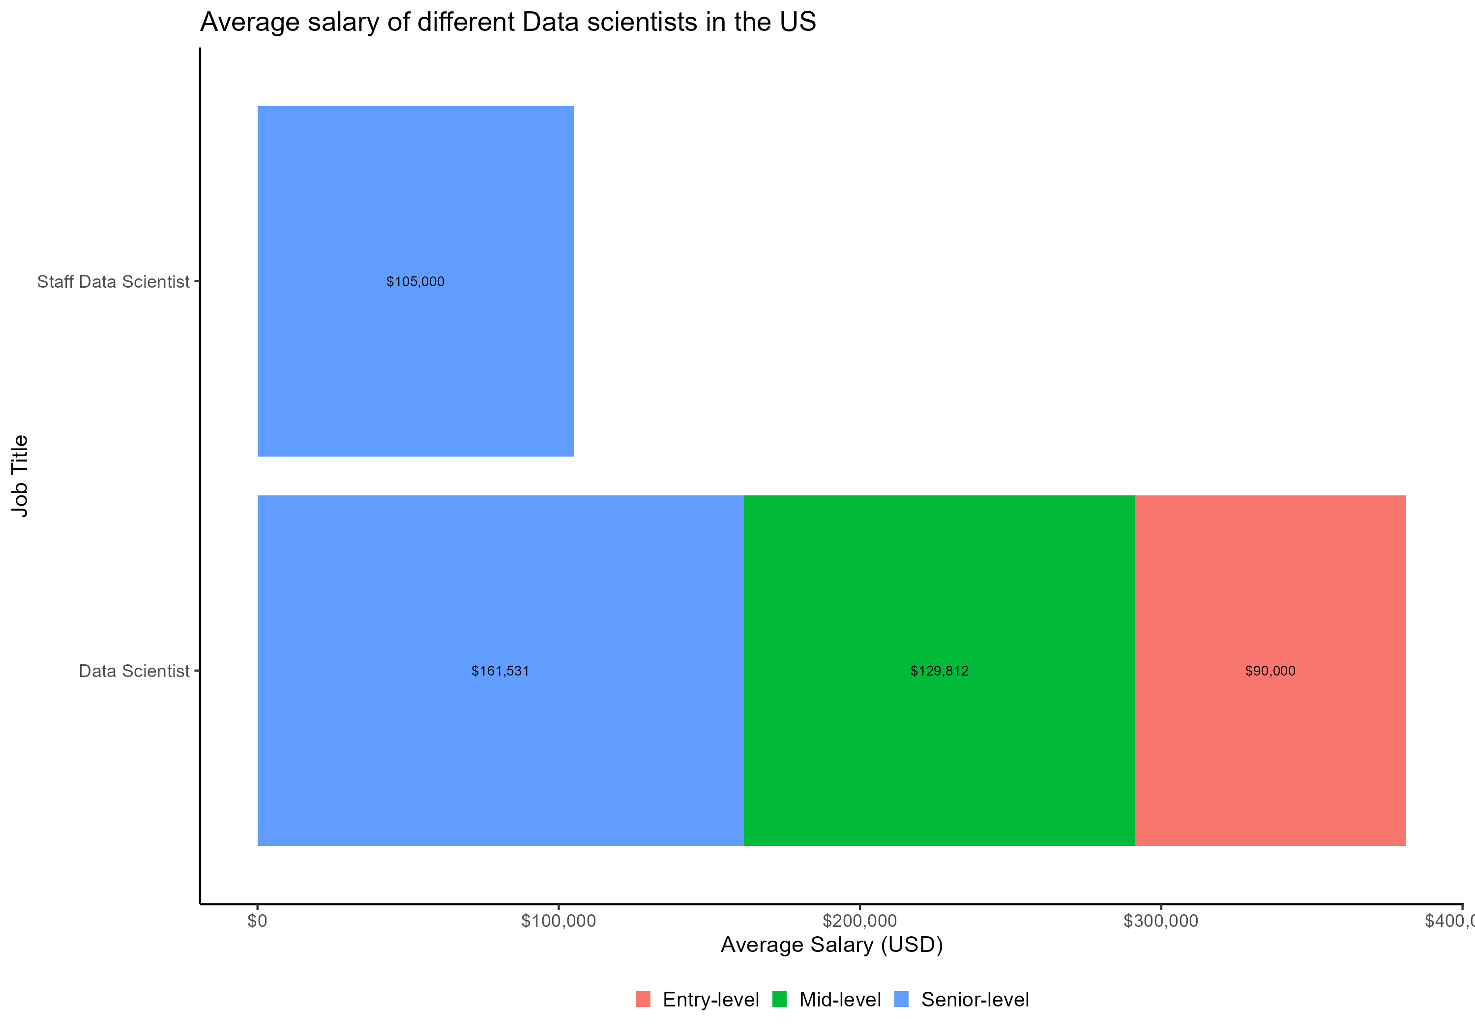
Salary by job Title and Experience
Here I wanted to point out that looking at the data there were several types of data scientist, and this was the order from entry level to senior or executive: Data Scientist, Applied Data Scientist, Staff Data Scientist, Lead Data Scientist, Principal Data Scientist.
As expected, based on their title and salary, the more experience you have the more your paid except those considered Staff scientist
Its important to note depending on the company, these role levels can be interchangeable.
Maybe a lot of places aren’t defining experience levels as staff, lead,etc but are given roles such as Data scientist 1,2,3
Also there doesn’t seem to be a lot of executive level role data at all, this could because there aren’t jobs offered for an executive data scientist position or people are just simply comfortable with where they are.
Notes:
Here I wanted to point out that looking at the data there were several types of data scientist, and this was the order from entry level to senior or executive: Data Scientist, Applied Data Scientist, Staff Data Scientist, Lead Data Scientist, Principal Data Scientist.
As expected, based on their title and salary, the more experience you have the more your paid except those considered Staff scientist
Its important to note depending on the company, these role levels can be interchangeable.
Maybe a lot of places aren’t defining experience levels as staff, lead,etc but are given roles such as Data scientist 1,2,3
Also there doesn’t seem to be a lot of executive level role data at all, this could because there aren’t jobs offered for an executive data scientist position or people are just simply comfortable with where they are.

Slide 4
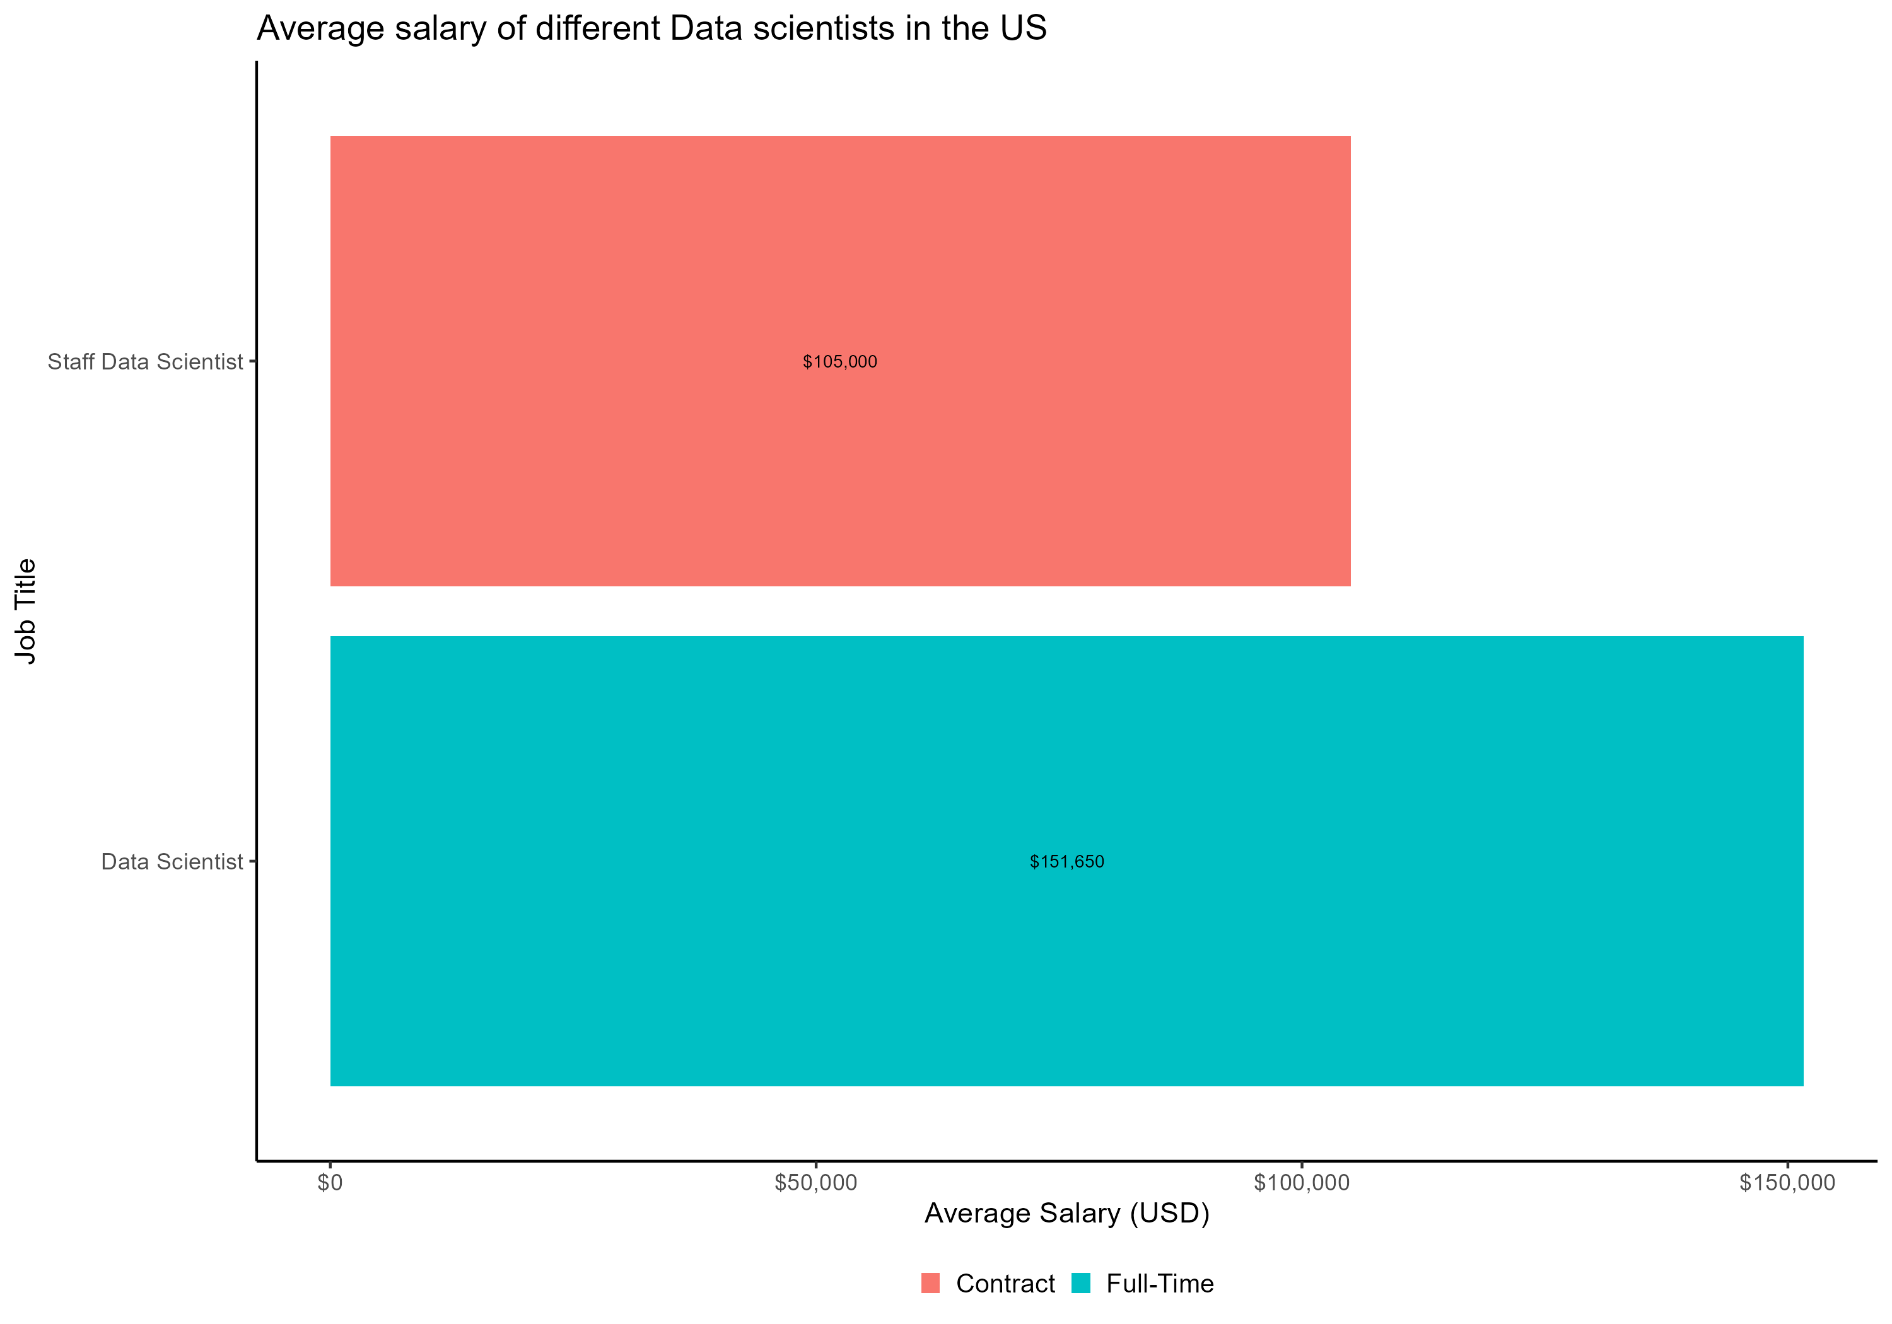
Salary by Employment Type
Again, out of all the data scientist working, we see that there are no other roles besides Data scientist and Staff data Scientist
There are really no part time roles or people don’t like to be part time data scientist
Contract roles seem to make about 30% less than Full time roles
Companies seem to be able to pay more for full time employees in exchange for commitment.
Notes:
Again, out of all the data scientist working, we see that there are no other roles besides Data scientist and Staff data Scientist
There are really no part time roles or people don’t like to be part time data scientist
Contract roles seem to make about 30% less than Full time roles
Companies seem to be able to pay more for full time employees in exchange for commitment.

Slide 5
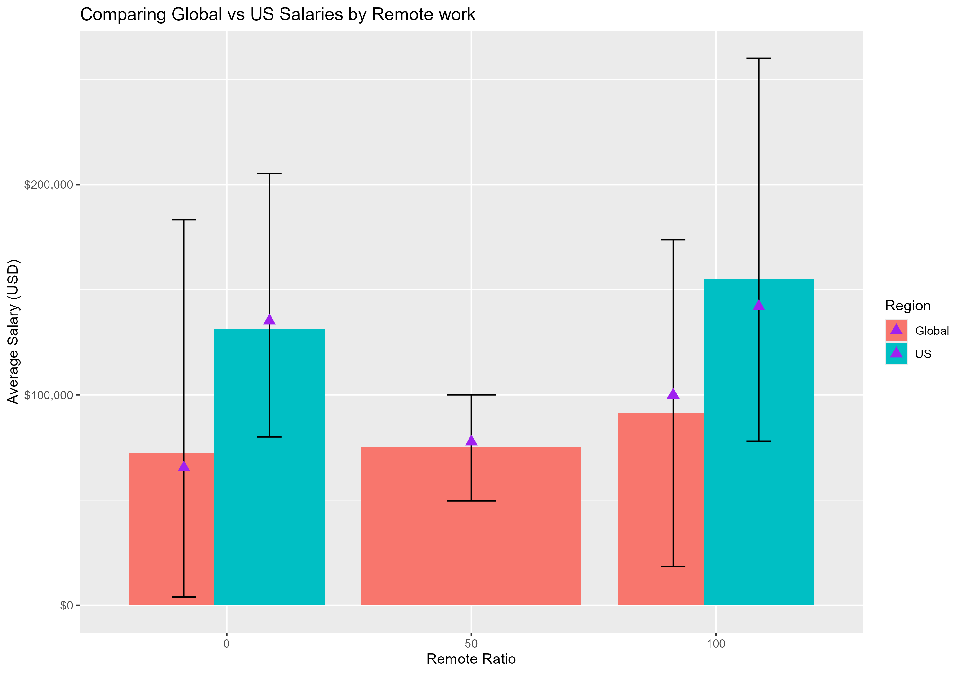
Salary by Remote work
First important thing to note is that the US seems to have no partial remote work for data scientists – its either all in or all out
The error bars represent spread of salaries so shorter bars indicate more clustered salaries and longer bars indicate a wider range of salaries
Longer bars for 100% remote suggests more variability
The US data scientists seem to make significantly higher than data scientists Globally (not in the US)
Fully remote roles seem to have the highest average salaries in the US
US salaries especially remote roles seem to be significantly higher and more predictable.
Remote roles overall globally are significantly lower
Notes:
First important thing to note is that the US seems to have no partial remote work for data scientists – its either all in or all out
The error bars represent spread of salaries so shorter bars indicate more clustered salaries and longer bars indicate a wider range of salaries
Longer bars for 100% remote suggests more variability
The US data scientists seem to make significantly higher than data scientists Globally (not in the US)
Fully remote roles seem to have the highest average salaries in the US
US salaries especially remote roles seem to be significantly higher and more predictable.
Remote roles overall globally are significantly lower

Slide 6
Final Recommendations
The CEO is looking to drive data scientist within the company so I would say focus on a US based Data scientist who is mid to senior level and can potentially run a team in the future.
Recommended salary Range: $141,000-$168,000
If the company wants to start off by hiring an executive level Data scientist, then I recommend a salary of $200,000-$260,000
If the company wants to save money, they can hire globally and expect to pay $72,000-$102,000 or offer a little higher to be competitive and this could be a range of $102,000-$141,000.
Invest in Full time employees to guarantee commitment and long-term growth
Prioritizing Fully Remote for the US may attract top talent. Globally this would have to be the same but offering those salaries above the global ranges could help better attract top talent.
As the company goes from medium to large consider a hybrid team of data scientist (meaning some US based and some globally based).

